Slide 1
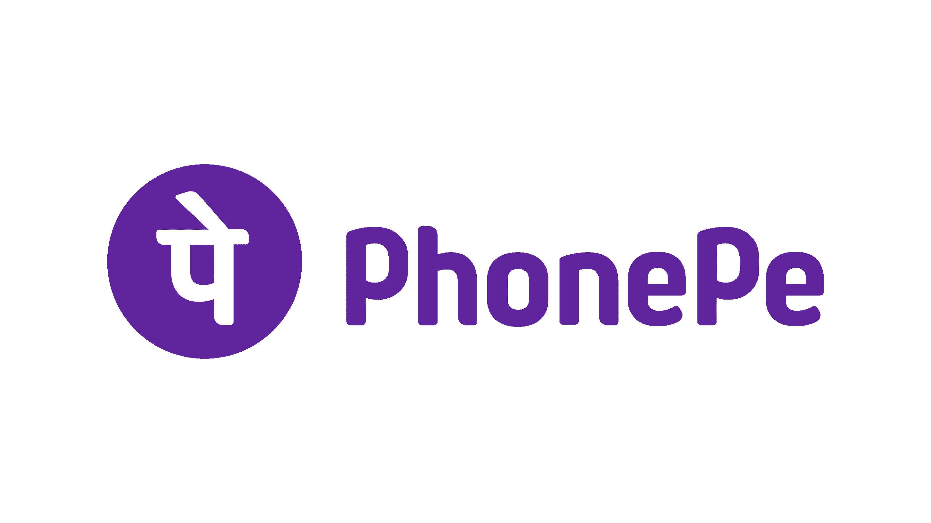
TRANSACTION INSIGHTS
Mohan raj
Sr Component Engineer

Slide 2
OBJECTIVE
To develop a comprehensive geo-analytical dashboard that leverages digital payment data to uncover transaction patterns, user engagement trends, and insurance adoption across india.
The project aims to deliver actionable insights through category-wise analysis, geographic visualizations, and performance benchmarking at state, district enabling data-driven decision-making for fintech stakeholders and policy planners.

Slide 3
SCOPE OF WORK
Customer segmentation analyze: User-level transaction patterns to identify distinct customer segments based on spending behavior, enabling personalized marketing and product targeting.
Geographical insights map: Evaluate payment trends across states to uncover regional variations, support location-based strategies.
User engagement analysis: Monitor user activity metrics to assess engagement levels, identify agitate risks, and inform strategies that enhance retention and overall user satisfaction.
Insurance transaction insights: Examine insurance-related payment data to evaluate adoption rates, user preferences, and product performance—guiding improvements in offerings and customer experience.
Chronological trend analysis: Track and visualize transaction trends over time to detect seasonal patterns, forecast demand fluctuations, and support strategic planning.

Slide 4
TOOLS & TECHNOLOGIES
Data wrangling: python, pandas
Visualization: matplotlib ,plotly, seaborn, streamlit
Geospatial mapping: geojson, plotly choropleth
Dashboard deployment: streamlit with modular UI and emoji-enhanced interactivity

Slide 5
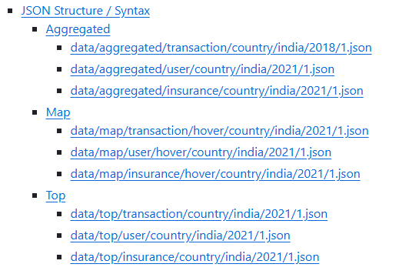
DATA EXTRACTION AND DATA FRAME CREATION
PhonePe pulse data extraction from GitHub repository.
Extraction of the pulse data is done by ‘clone’ method into the local drive
Accessing the folder with nested for loops to extract the data
Dataframe is created with required input

Slide 6
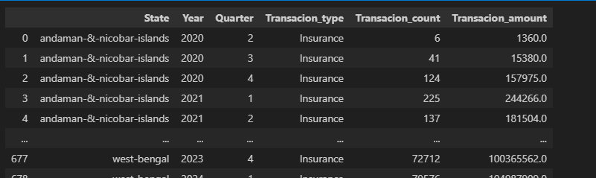
DATA EXTRACTION AND DATAFRAME CREATION
Extracted data is validated for there “dtype “,” non-null count”,” column”
If duplicate are found same is removed from the DF
Then the cleaned data is stored to the ‘MY SQL”

Slide 7
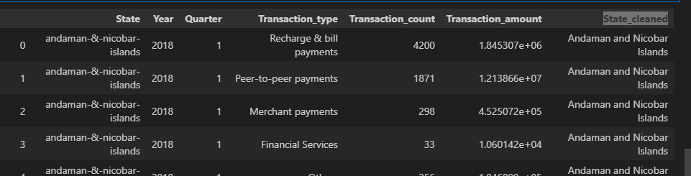
DATA EXTRACTION AND DATAFRAME CREATION
Geo-Insight
In case of geo-insight across the Indian states I have used “geojson_url”
Mapping the states id from table to the state list in the geojson is complex due to the mismatch
Using map function all the state is mapped to geojson and created a column name “state_cleaned” which is used for further analysis

Slide 8
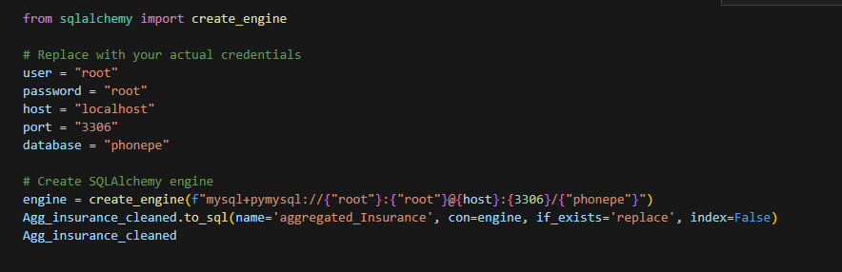
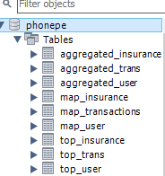
SQL DATABASE AND TABLE CREATION
Set up a connection between your cleaned DataFrame and MySQL database using ‘sqlalchemy’s ‘
Define MySQL credentials
Creates A connection engine that lets pandas or sqlalchemy's talk to your MySQL database.
Create a database in my SQL with the name “PhonePe ”
Finally moved the created DataFrame to ‘My SQL’ under the database “PhonePe”

Slide 9
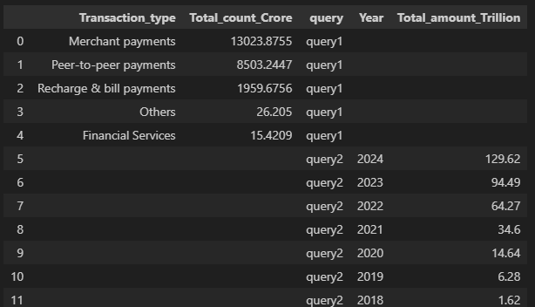
DATA ANALYSIS – BUSINESS USE CASES
Based on the use cases tables from the “my SQL” is pulled in for further analysis
Example- customer segmentation - transaction type vs transaction count – query are used for data manipulation
Manipulated data is stored in the DF for further utilization

Slide 10
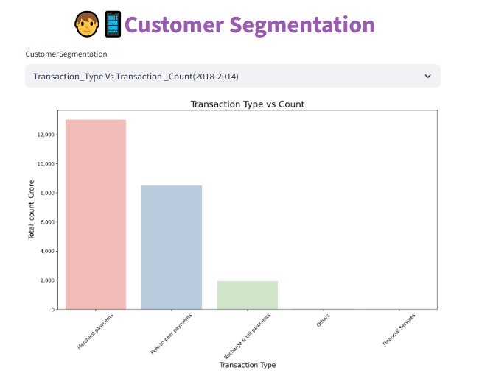
Data Visualizations-Customer Segmentation
Among all the transaction type across years top contributor within customer base is “merchant payment”
Least is the financial services
We can conclude more customer base can be built by focusing on the merchants and peer to peer payments methods

Slide 11
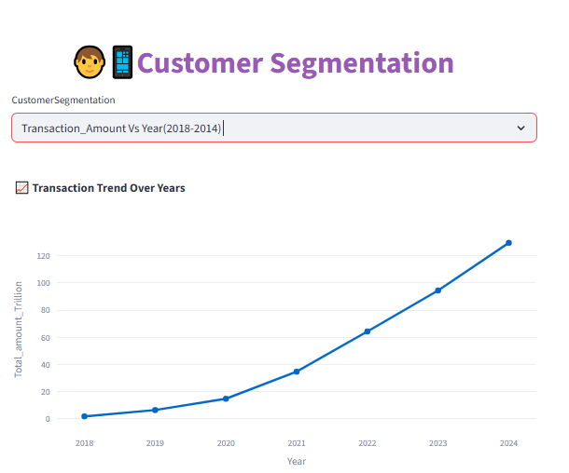
DATA VISUALIZATIONS-CUSTOMER SEGMENTATION
Transaction amount vs years will give a clear insight on India's growth on the digital payment
2018 -2020 was the year the word digital payment was picking up among Indian populations
From 2021 growth was phenomenon with exceptional transaction amount

Slide 12
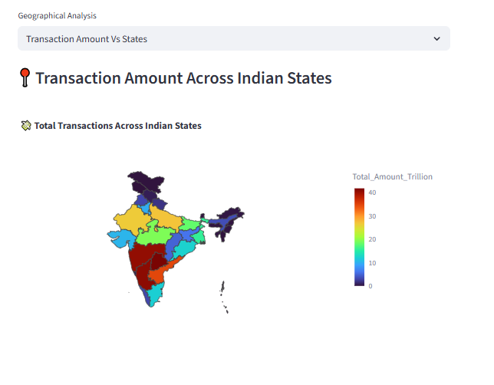
GEOGRAPHICAL ANALYSIS
Most transaction was made in the state Maharashtra and Karnataka surpassing 40 trillions
Maharashtra is the financial capital of India and most of the transaction from Karnataka are from Bangalore IT hub
More focus can be made in the north east states where internet accessibility is low.
Also states like Tamilnadan and Andhra are to be focused since more customer are available

Slide 13
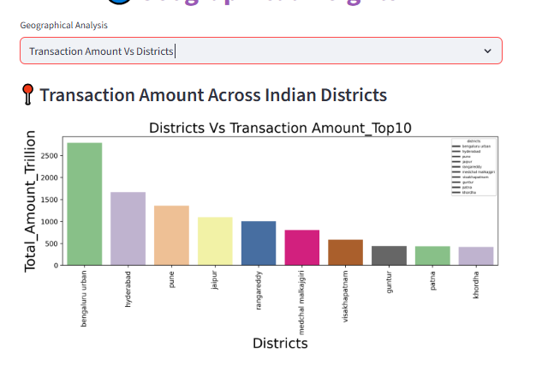
GEOGRAPHICAL ANALYSIS-DISTRICTS
In line with the comment in the above slide “Bangalore urban contribute highest among the districts

Slide 14
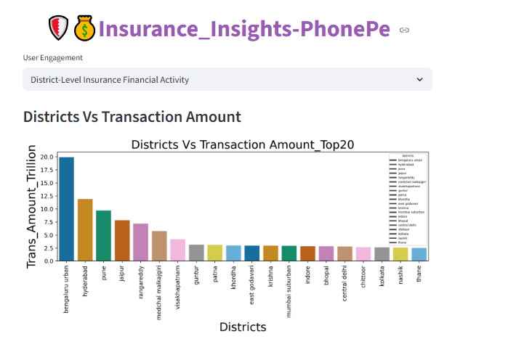
INSURANCE INSIGHTS
Top contribution districts is Bangalore urban and the least is the thane.
We do have metro cities with lesser transaction even though the per capita income is higher in these districts . we can push the market in these areas

Slide 15
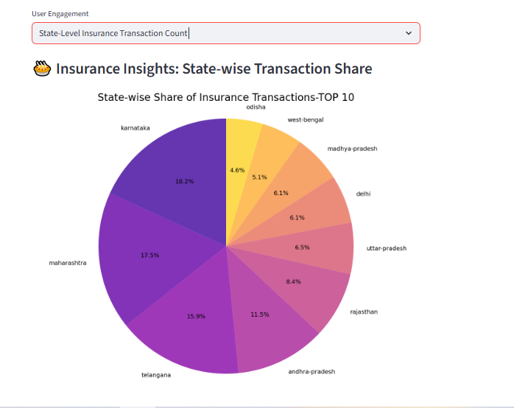
INSURANCE INSIGHTS
Most insurance transaction was made in the state Maharashtra and Karnataka.

Slide 16
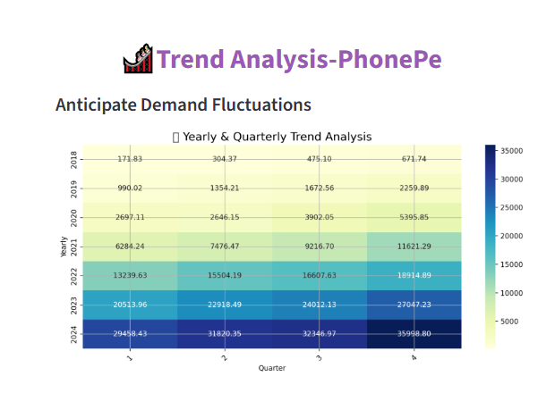
TREND ANALYSIS-ANTICIPATED DEMAND FLUCTUATIONS
Q3 and Q4 are the top demand quarter among the all.
I believe the festival demand and offers related the festival have increase the demands
Q1 and q2 are the least
Still, i could able to see the demand in 2023 -24 across quarters because of more online transaction and its growth

Slide 17
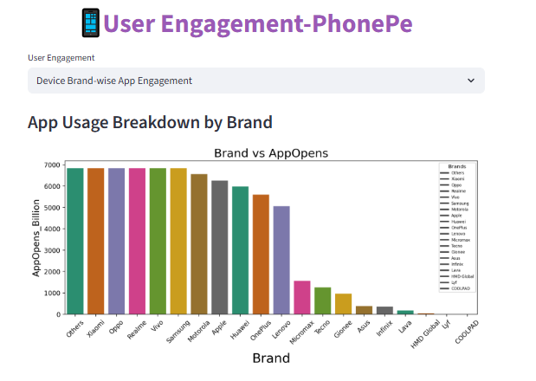
USER ENGAGEMENT
It was strange to see brand like “other” have contributed more in the app usage
Top brands like samsung, apple ,moto are lagging behind the chinese brands.
Data is upsetting for top brands

Slide 18
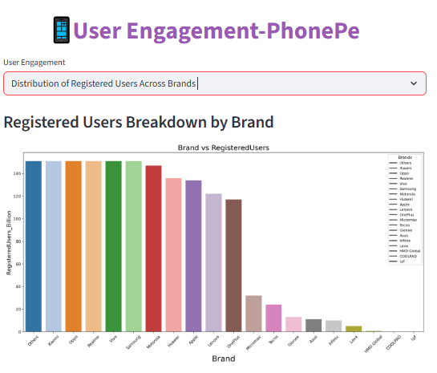
USER ENGAGEMENT
Scenarios remains the same for the registered users across the brands
May be budget friendly brands have more customer base across the country

Slide 19
THANK YOU

